Slide 1
Therap.ai
Programme: B.Tech
Presented by: Hersh | Sharvil | Hrishil | Madiha
Mentor: Prof. Ishani Saha

Slide 2
Roadmap
Introduction
Problem Definition
Work done
Literature Survey
Architecture
Design Diagrams
Implementation
References

Slide 3
Introduction
The current medical system is ill-equipped to assist patients in distress.
According to statistics, 76-85% of individuals in low-middle-income nations lack adequate resources or qualified health care providers.
Various researchers have come up with methods that leverage technology to make mental healthcare more accessible in order to tackle these difficulties.
Chat-bots, backed by various psychological approaches and computational techniques, are a typical strategy that addresses most of the challenges and eliminates the need for a middleman while offering a sense of comfort to the user.

Slide 4
Problem Definition
The aim of our project is to streamline the process of attaining help for mental health disorder. We aim to create an app which primarily has a chatbot trained on the Counselchat dataset and uses the the PHQ questionnaires to determine the mental state of the user. It additionally offers micro-activities and a mental health resource book for the users.

Slide 5
Work Done
Literature and market survey
Review paper
Selected in IEEE 7th International Conference for Convergence in Technology, I2CT, Pune, India.
Dataset generation and preprocessing
Trained a chatbot model using various ML techniques.
Created a website featuring micro-activities and a mental health resource book.

Slide 6
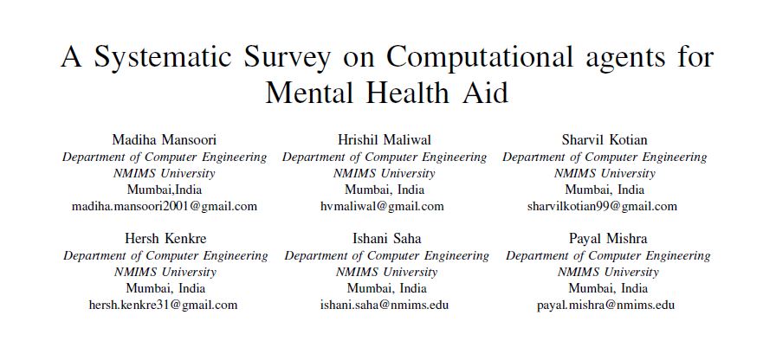
Literature Survey
Selected In: IEEE 7th International Conference for Convergence in Technology, I2CT, Pune, India.

Slide 7
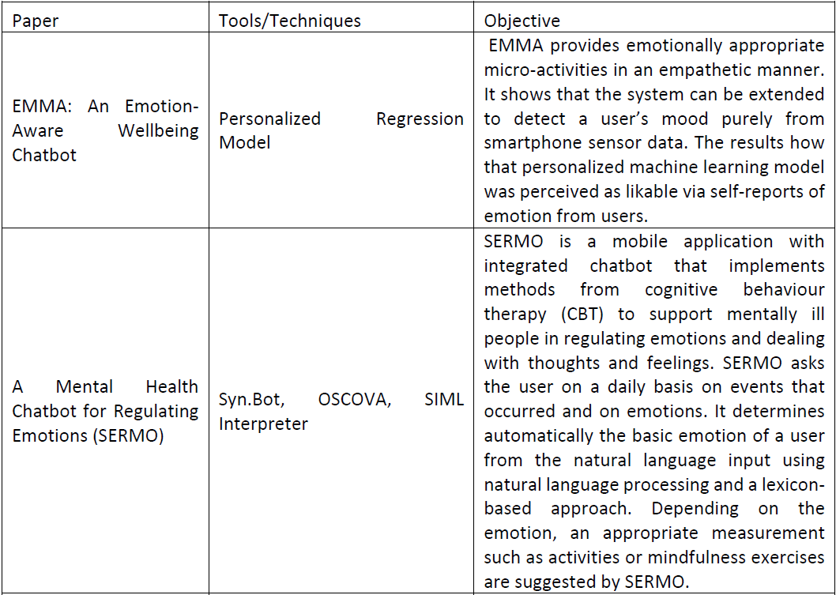
Literature Survey

Slide 8
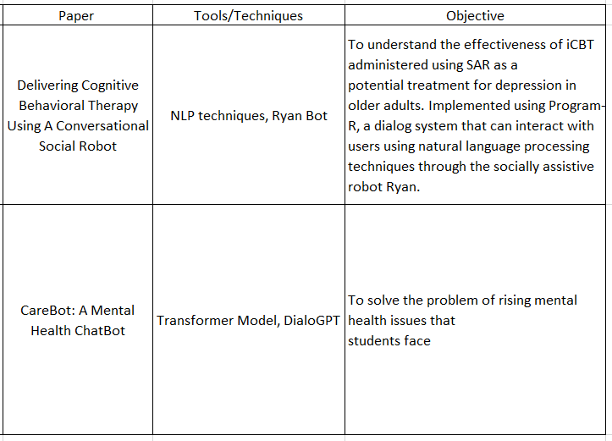
Literature Survey

Slide 9
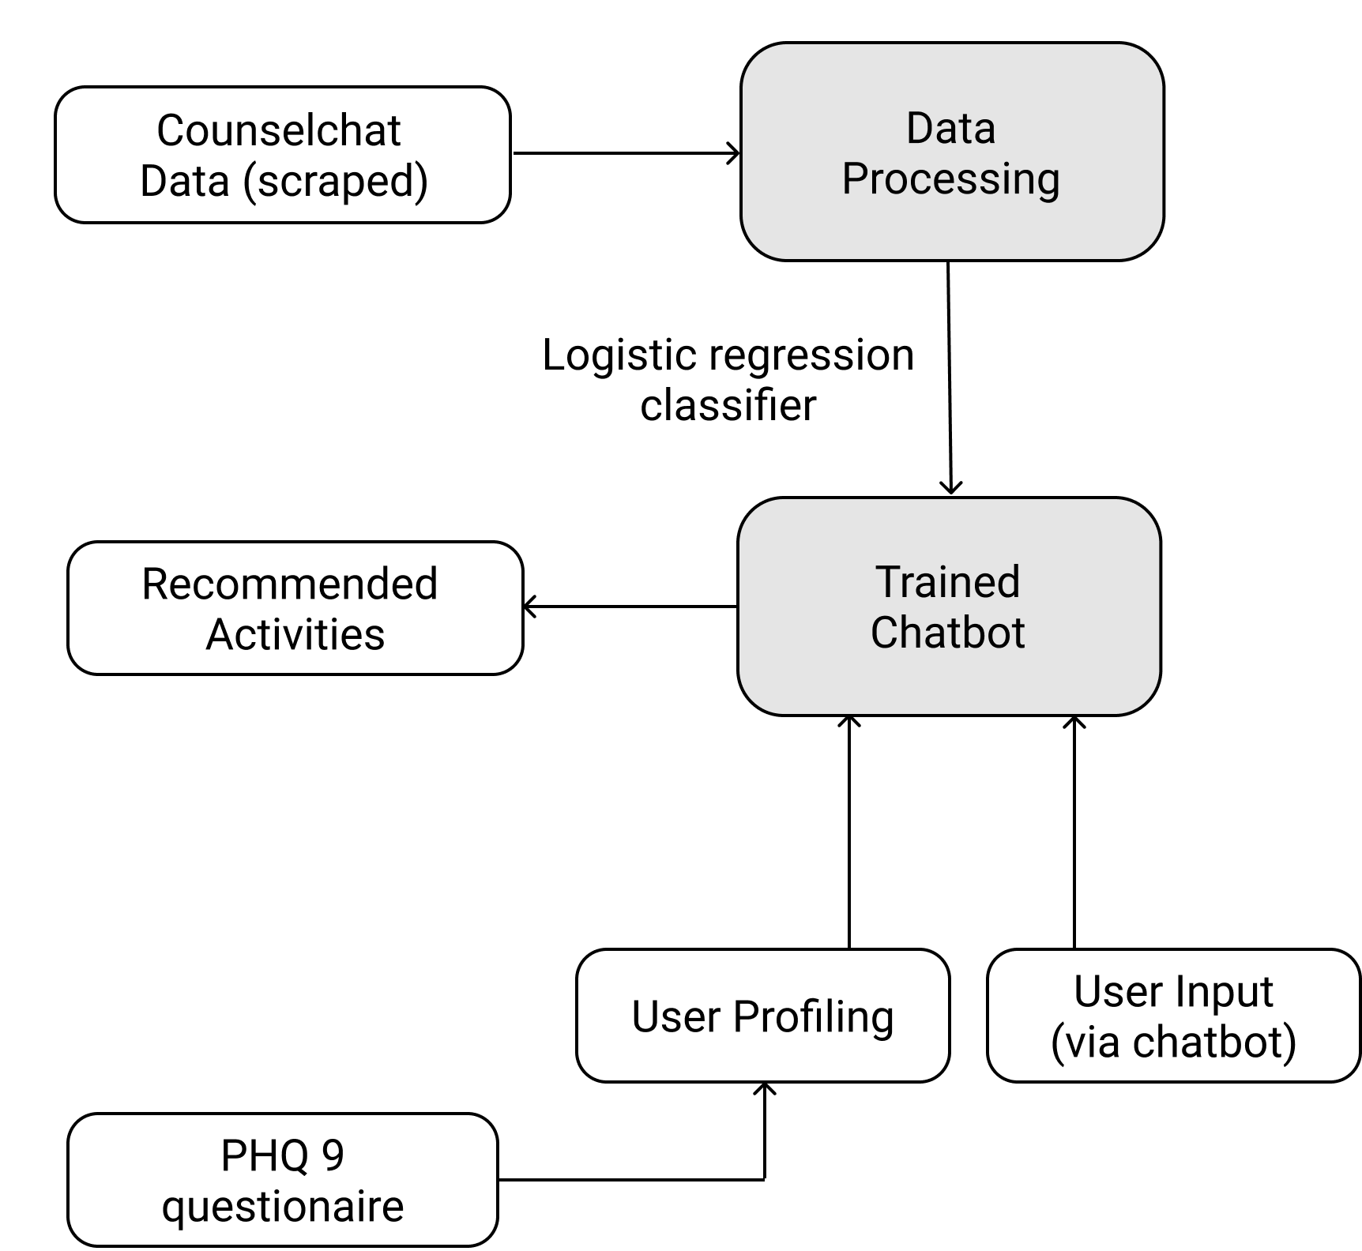
Architecture
Figure 1. Architecture Diagram

Slide 10
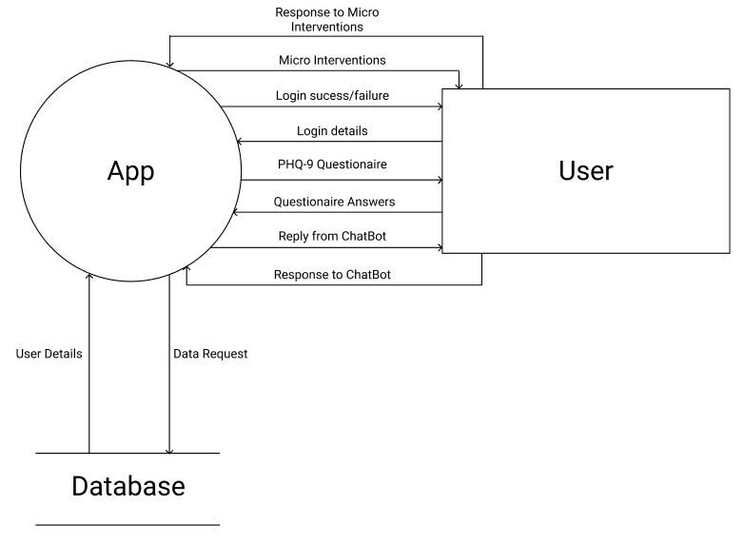
Design(Dataflow Diagram)
Figure 2. Level 0 DFD

Slide 11
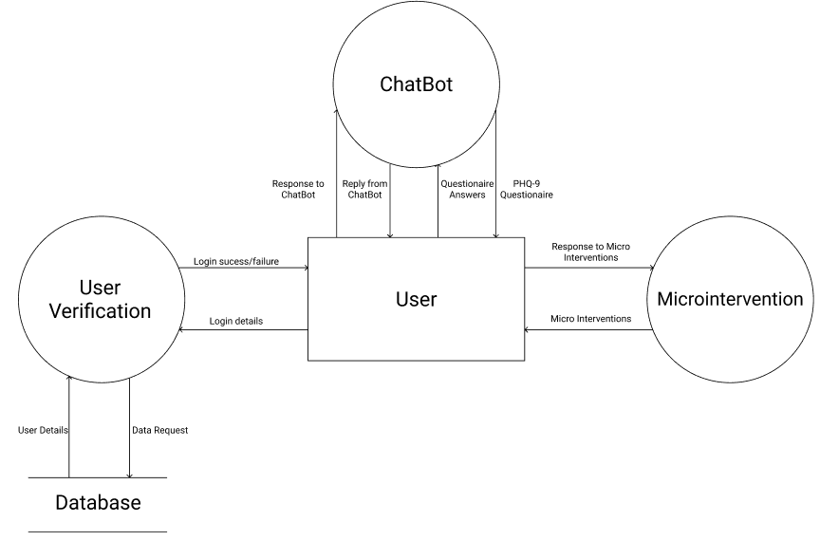
Design(Dataflow Diagrams)
Figure 3. Level 1 DFD

Slide 12
Implementation (Dataset)
Counsel Chat is a professional network that connects counsellors with people who could be potential patients. These counselors are verified therapists, which enhances the reliability of responses.
The forum features 31 topics, with several responses for the most of them. The themes vary from intimacy and relationships to self-harm and military traumas.
The data set was prepared by scraping data from the website and comprises of ten distinct attributes like question text, topic, answer text, and upvote count.

Slide 13
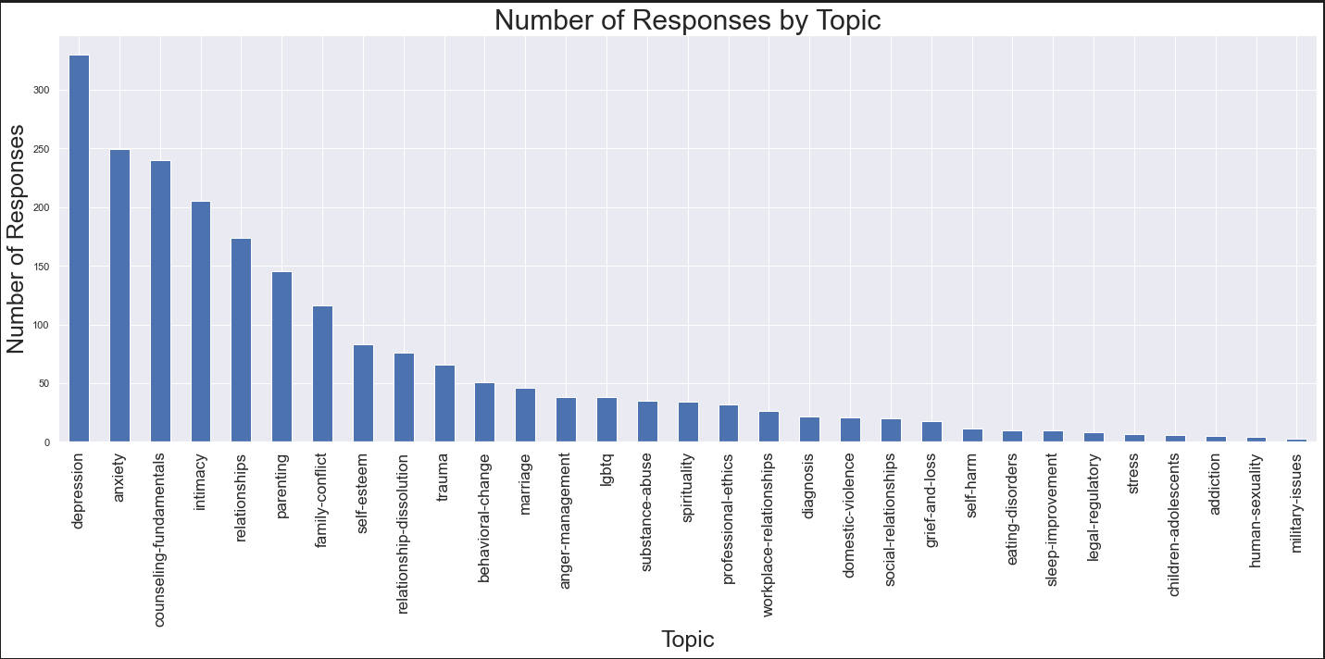
Data Exploration
Figure 8. Distribution of Responses by Topic

Slide 14
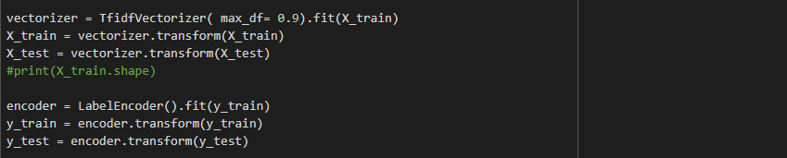
Implementation (Model Exploration)
Logistic Regression Classifier

Slide 15
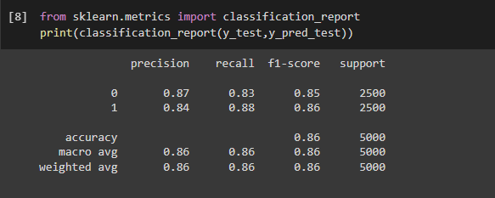
Logistic Regression
Model Description
Vectorizer: TF-IDF
Encoder: Label Encoder
Training Accuracy - 0.86965
Model Evaluation
Testing Accuracy - 0.8558

Slide 16
Implementation (PHQ-9 based)
The PHQ-9 form is a brief, self-administered questionnaire that assesses depression symptoms. PHQ-9 addresses multiple mental health concerns including depression, panic disorder, anxiety, sleep disorders, and others.
Score assessment
0-7 -> Mild
>=8 -> Extreme case

Slide 17
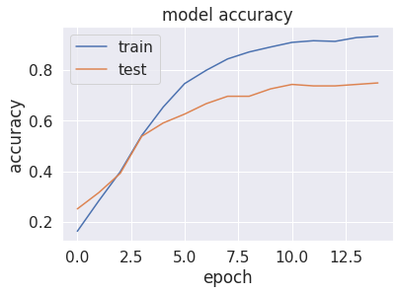
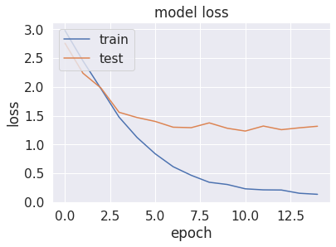
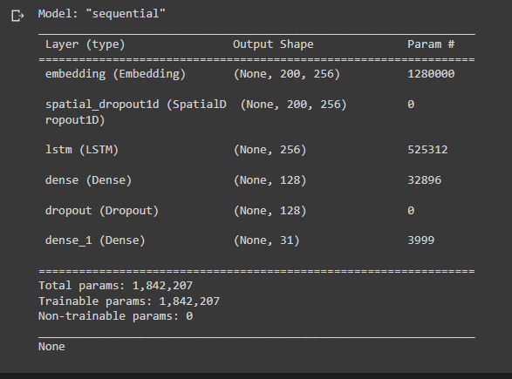
LSTM

Slide 18
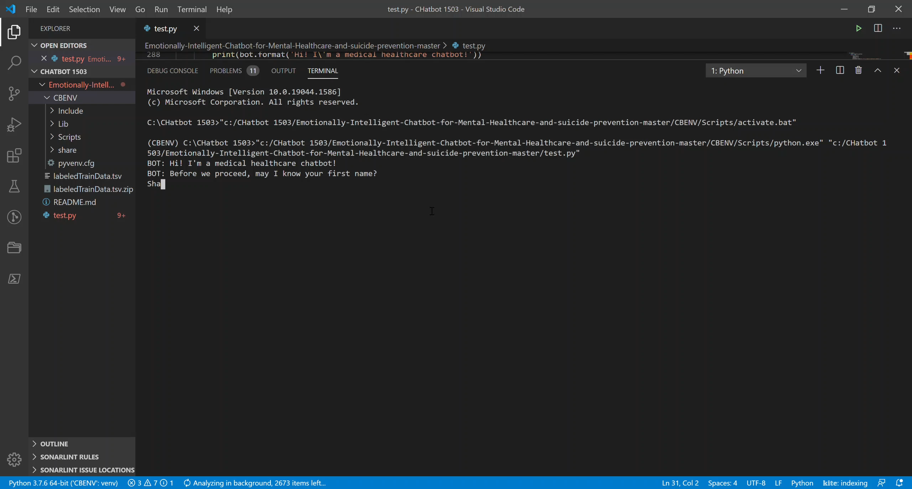
Chatbot Test Case 1

Slide 19
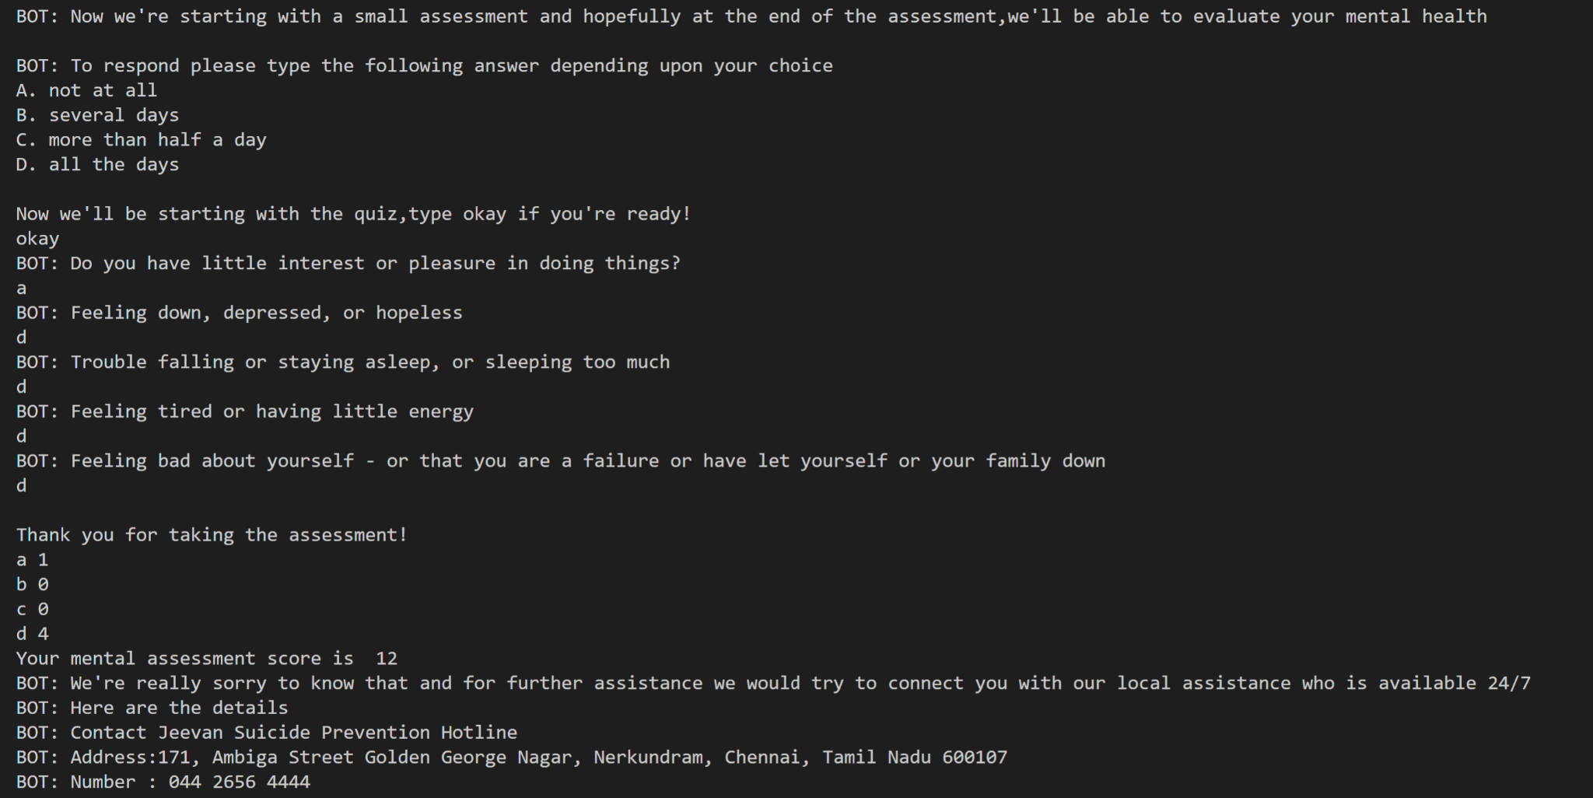
Chatbot Test Case 2

Slide 20
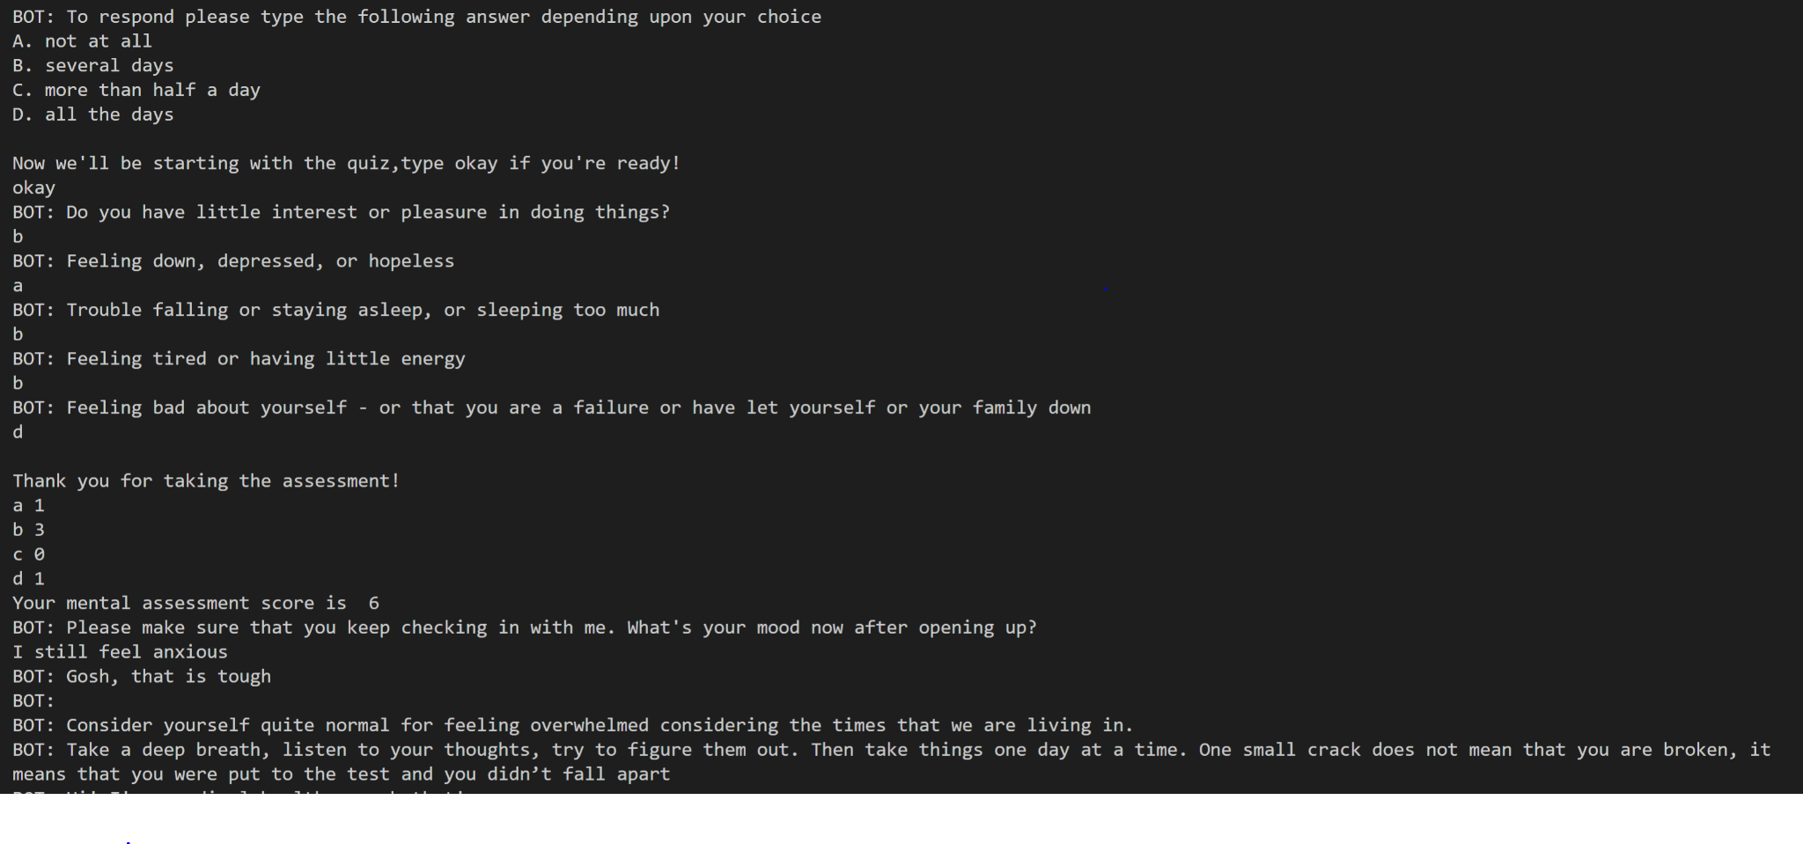
Chatbot Test Case 3

Slide 21
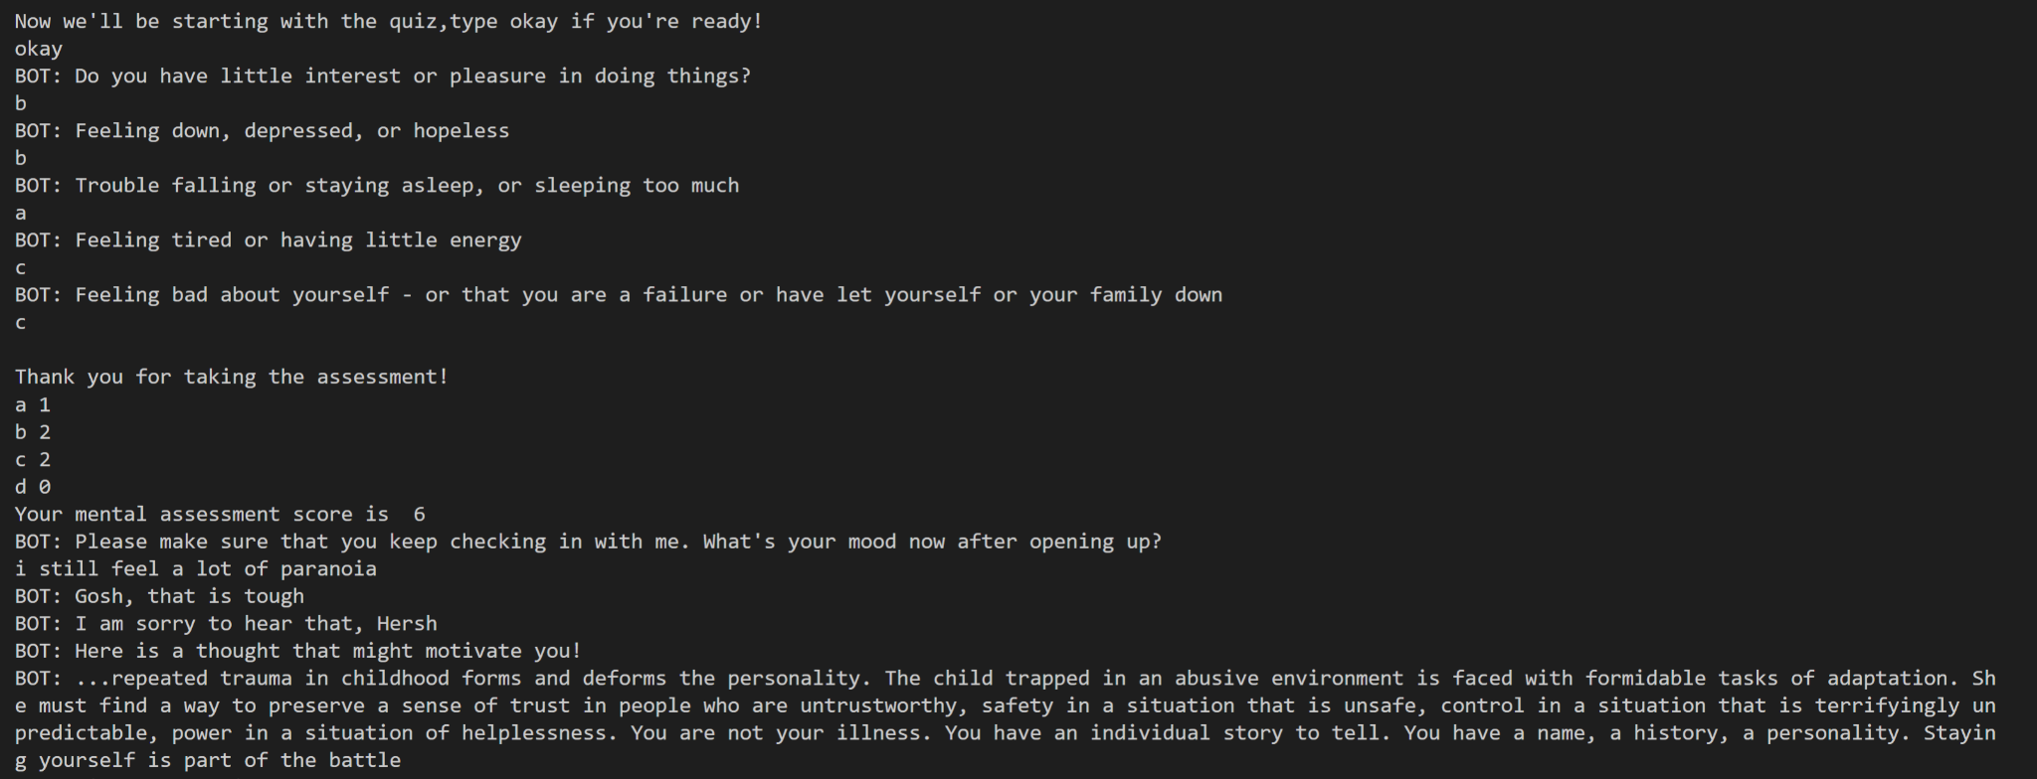
Chatbot Test Case 4

Slide 22
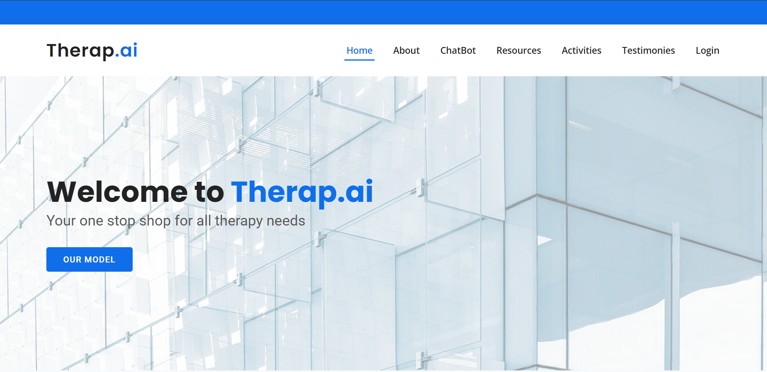
UI Design

Slide 23
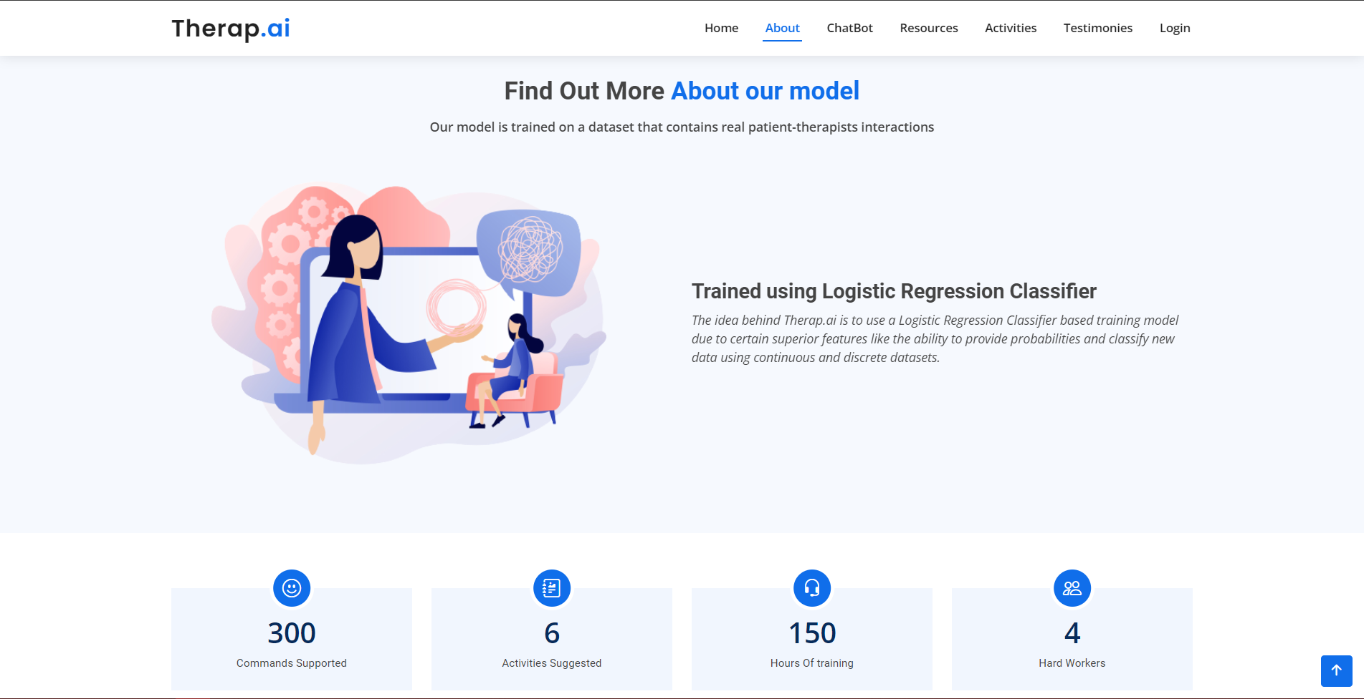
UI Design

Slide 24
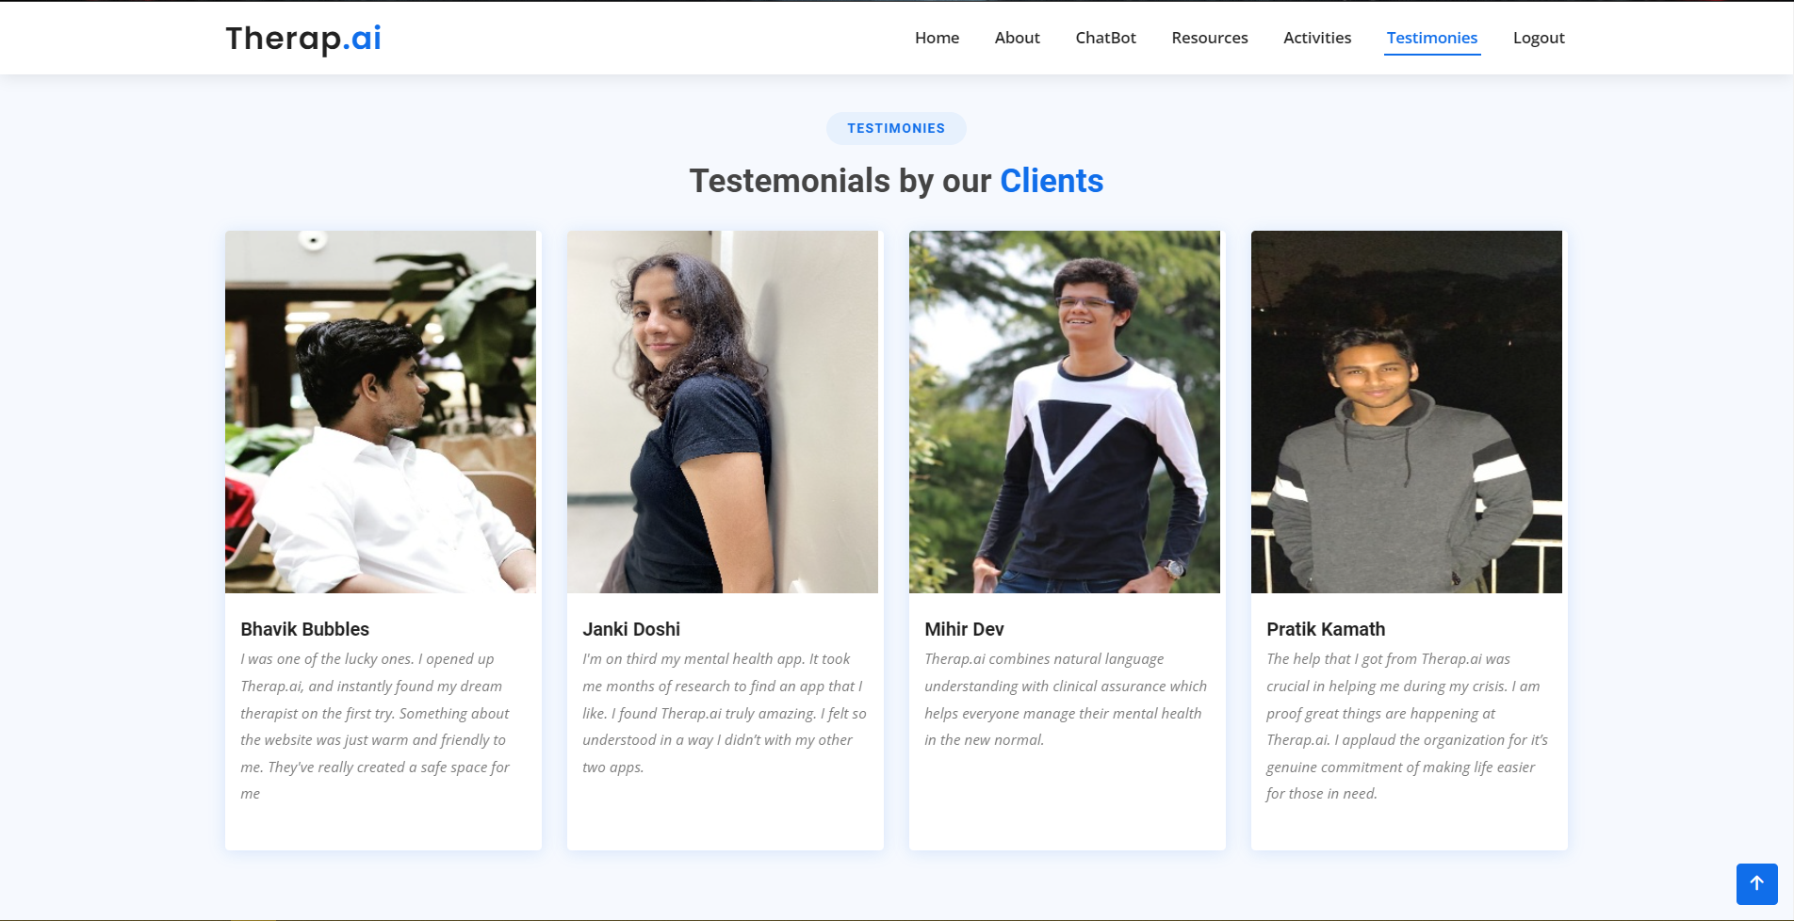
UI Design

Slide 25
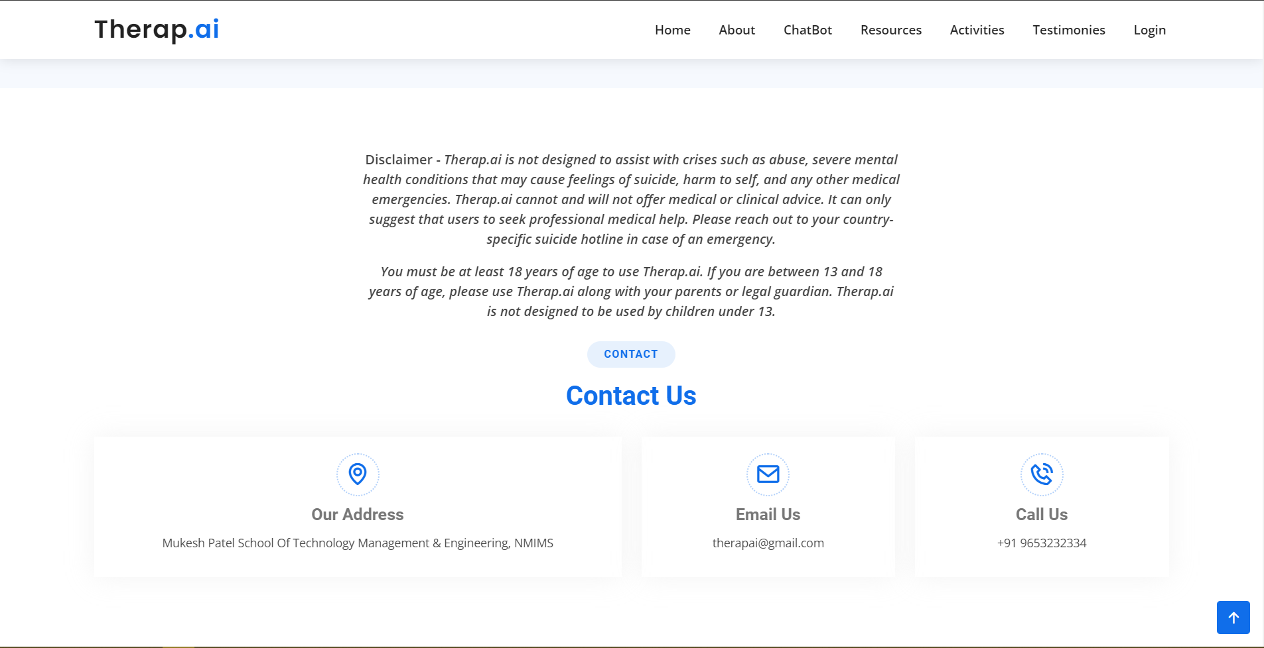
UI Design

Slide 26
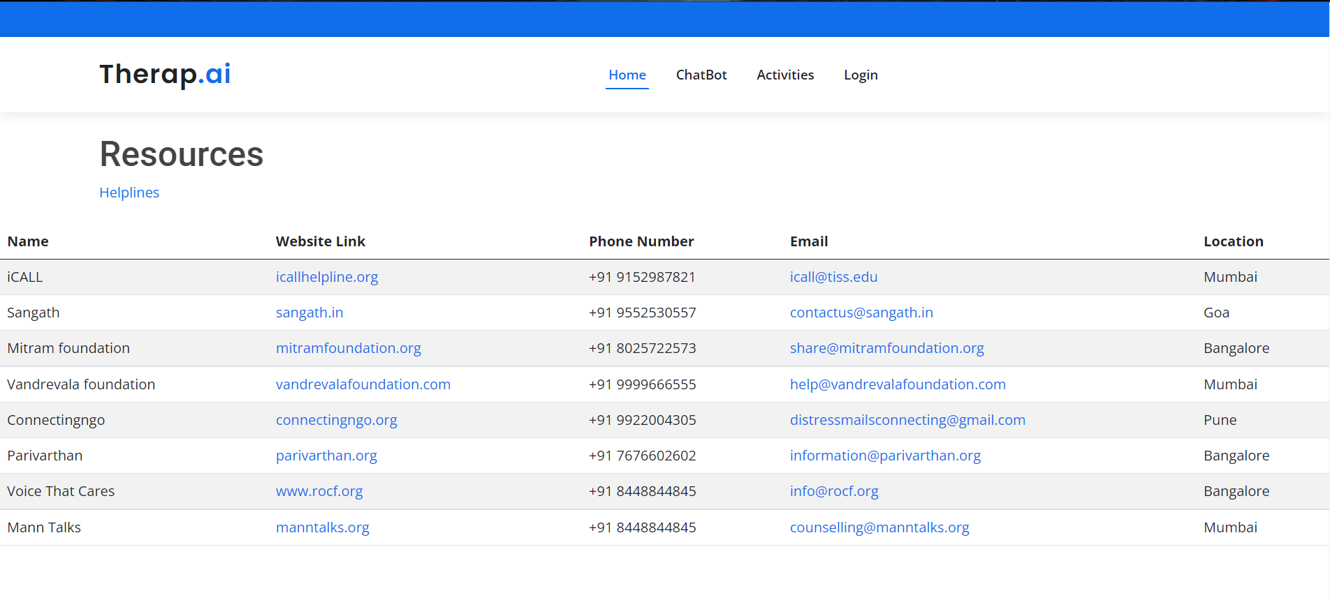
UI Design

Slide 27
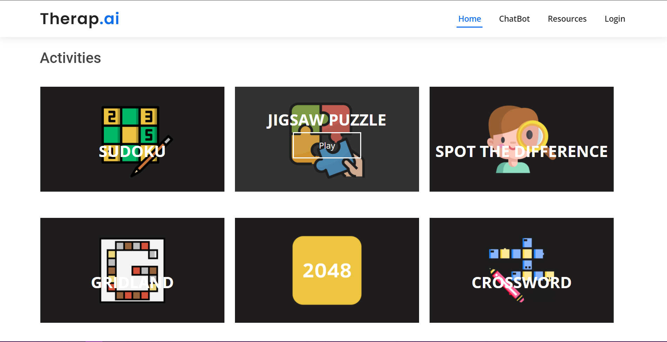
UI Design

Slide 28
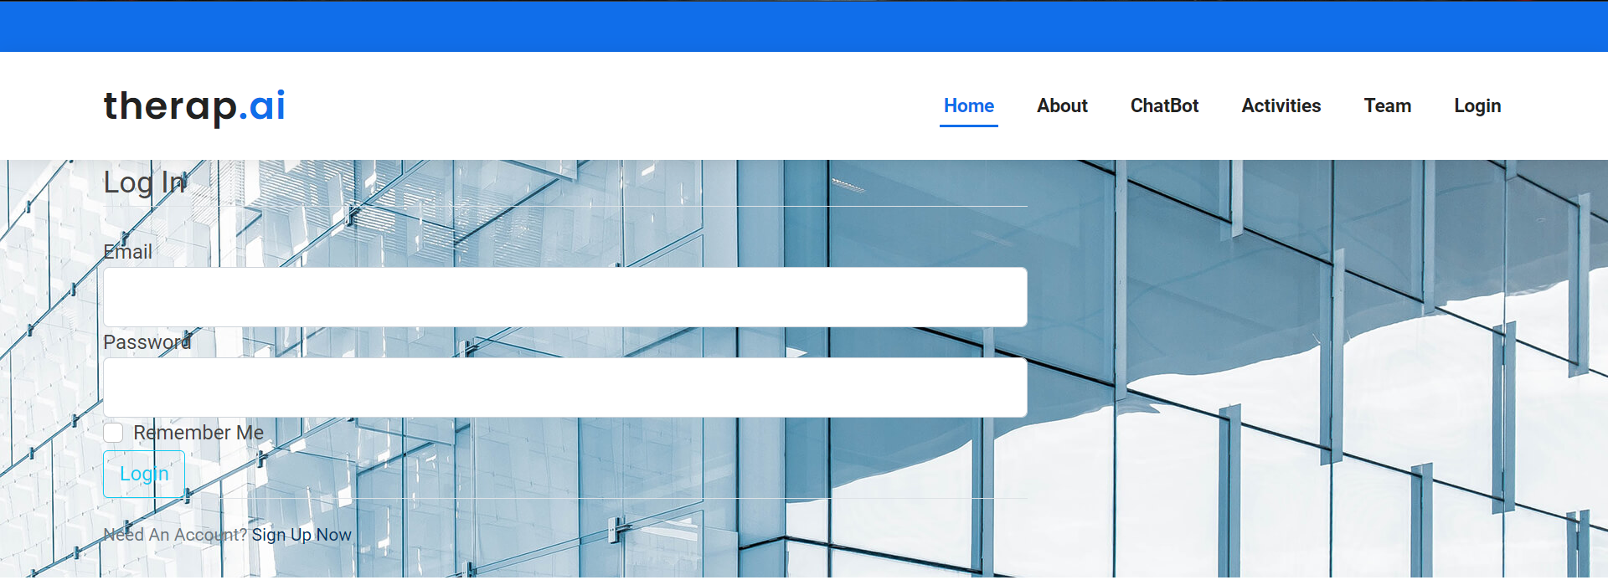
UI Design

Slide 29
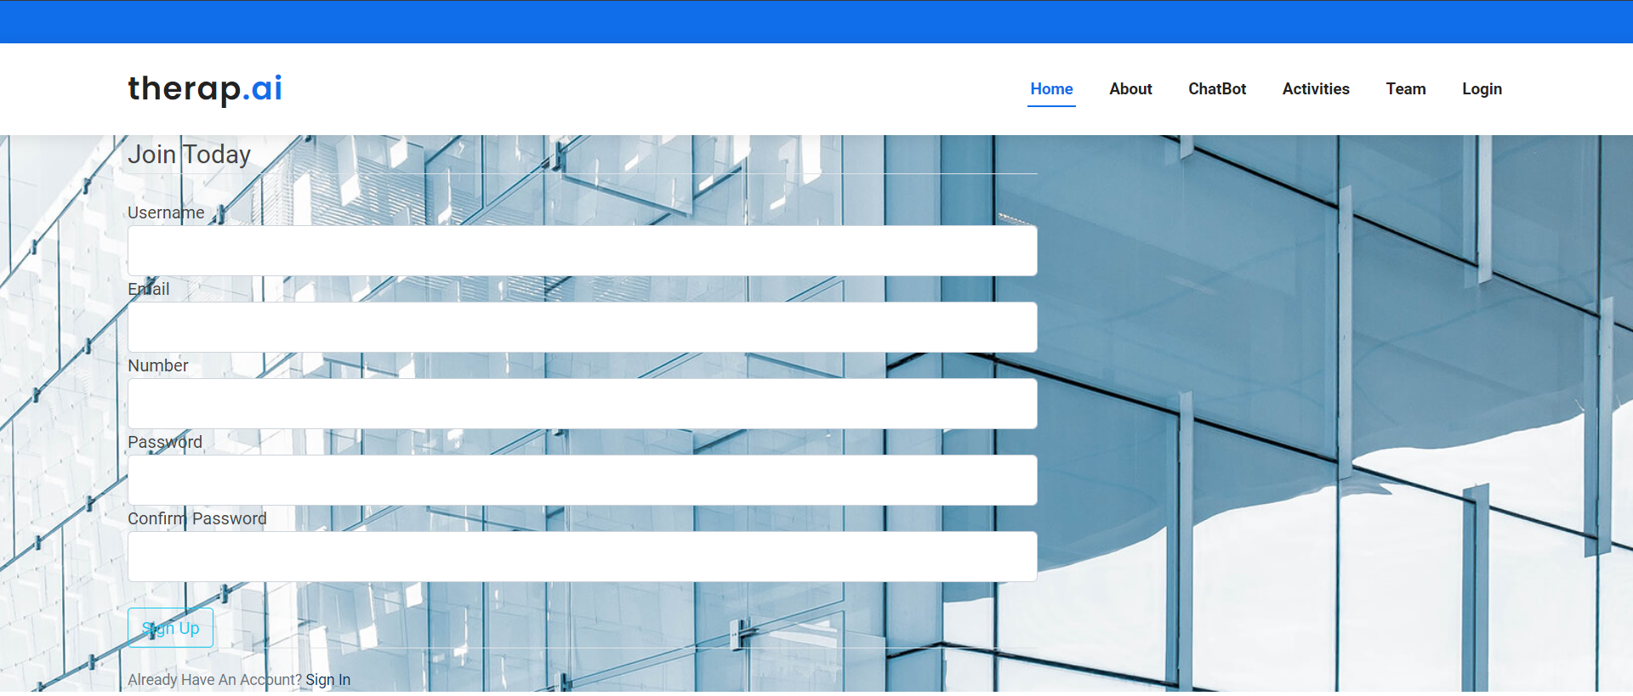
UI Design

Slide 30
References
[1] S. Graham et al., “Artificial Intelligence for Mental Health and Mental Illnesses: an Overview,”
Current Psychiatry Reports, vol. 21, no. 11, 2019, doi: 10.1007/s11920-019-1094-0.
[2] S. Carolan, P. R. Harris, K. Greenwood, and K. Cavanagh, “Increasing engagement with an
occupational digital stress management program through the use of an online facilitated
discussion group: Results of a pilot randomized controlled trial,” Internet Interventions, vol.
10, no. August, pp. 1–11, 2017, doi: 10.1016/j.invent.2017.08.001.
[3] Y. Zhang et al., “DIALOGPT : Large-Scale Generative Pre-training for Conversational
Response Generation,” pp. 270–278, 2020, doi: 10.18653/v1/2020.acl-demos.30.
[4] F. Patel, R. Thakore, I. Nandwani, and S. K. Bharti, “Combating depression in students using
an intelligent ChatBot: A cognitive behavioral therapy,” 2019 IEEE 16th India Council
International Conference, INDICON 2019 - Symposium Proceedings, pp. 2019–2022, 2019,
doi: 10.1109/INDICON47234.2019.9030346.
[5] S. Nagargoje, V. Mamdyal, and R. Tapase, “Chatbot for Depressed People,” in UIJRT | United
International Journal for Research & Technology, 2021, vol. 02, no. 07, pp. 208–211.

Slide 31
References
[6] R. Wang, J. Wang, Y. Liao, and J. Wang, “Supervised machine learning chatbots for perinatal
mental healthcare,” Proceedings - 2020 International Conference on Intelligent Computing
and Human-Computer Interaction, ICHCI 2020, pp. 378–383, 2020, doi:
10.1109/ICHCI51889.2020.00086.
[7] R. Goel, S. Vashisht, A. Dhanda, and S. Seba, “An empathetic Conversational Agent with
Attentional Mechanism,” in 2021 International Conference on Computer Communication and
Informatics (ICCCI), 2021, pp. 5–8. doi: 10.1109/ICCCI50826.2021.940233.
[8] F. DIno, R. Zandie, H. Abdollahi, S. Schoeder, and M. H. Mahoor, “Delivering Cognitive
Behavioral Therapy Using A Conversational Social Robot,” IEEE International Conference
on Intelligent Robots and Systems, pp. 2089–2095, 2019, doi:
10.1109/IROS40897.2019.8968576.
[9] K. Denecke, S. Vaaheesan, and A. Arulnathan, “A Mental Health Chatbot for Regulating
Emotions (SERMO) - Concept and Usability Test,” IEEE Transactions on Emerging Topics in
Computing, vol. 14, no. 8, 2020, doi: 10.1109/TETC.2020.2974478.
[10] P. das Monalisa and S. Kumar, “A Chatbot System For Mental Health Care,” pp. 1–5.

